Slide 1

ANZ Transaction data analysis
Piao Ye
Oct 13, 2020

Slide 2
3 Major Aspects of the Analysis
Overall statistics
Trends
Geospatial information

Slide 3
Overall Statistics
The data set contains 12043 entries of transaction data over the period of 2018-08-01 to 2018-10-31.
Among all the transactions, there are 7717 authorized and 4326 posted transactions. 6194 transactions had card present at the time of transaction.
There are 100 unique accounts from which the transactions were made. All accounts are in the format “ACC-” followed by 8-10 digits.
All transactions were made in AUD within Australia. The minimum, average, and maximum transaction amounts are 0.1, 187.93, and 8835.98 AUD, respectively.
All accounts had a valid balance. The minimum, average, and maximum balances are 0.24, 14704.20, and 267128.52 AUD, respectively.
6825 accounts were held by males and 5758 accounts were held by females. The minimum, average, and maximum ages of account holders are 18, 28, and 78 years old, respectively.
The transactions were divided into 6 categories: 32.7% SALES-POS, 31.4% POS, 21.6% PAYMENT, 7.3% PAY/SALARY, 6.2% INTER BANK, and 0.8% PHONE BANK.

Slide 4
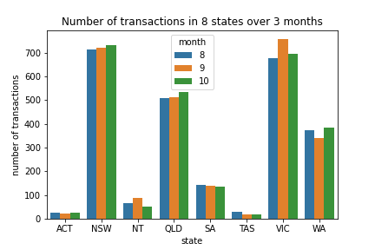
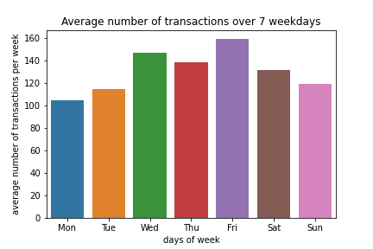
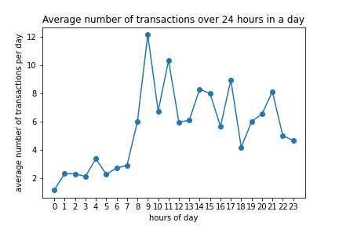
Trends
NSW, QLD and VIC had the most transactions in all 3 months among the states. ACT, NT and TAS had the least transactions. Number of transactions didn’t differ much by months.
There were 14 Wednesdays and 13 other weekdays during the 3-month period. After averaging, it is found that most transactions take place on Friday after a week’s work. Least transactions take place on Monday when people go back to work.
The average number of transactions fluctuate over the hours of a day. Generally, transactions tend to happen between 8 am and 11 pm. Several peaks in this period include 9 am, 11 am, 5 pm, and 9 pm.

Slide 5
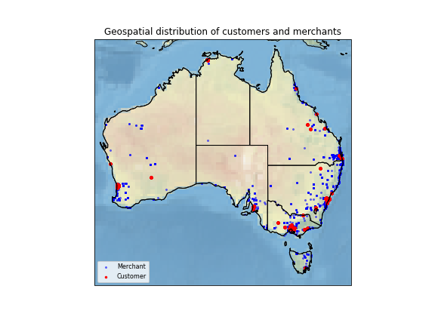
Geospatial Information
Customers of these transactions reside mainly on the southeast coast of Australia, with a few on the west and north. Populated areas include Sydney, Canberra, Melbourne, Brisbane, Perth, Geraldton, Kalgoorlie, Adelaide, Darwin, and etc. Merchants are more scattered than customers but are also mainly distributed on the east, southeast, and west.

